Slide 1
Graphing and writing Linear EQUATIONS
By Andrew and Matthew Valentine

Slide 2
Types of Linear equations
Linear Equations have the formula Ax + By + C = 0 where A and B are both nonzero numbers.
When Ax + By = C, and A is positive, the equation is in standard form
Slope-intercept form is y = mx + b
Point-slope form is y – y₁ = m (x – x₁)

Slide 3
Slope
The formula for slope is m = y₂ – y₁
x₂ – x₁
Slope is rise over run, or y x
There are four types of slope

Slide 4
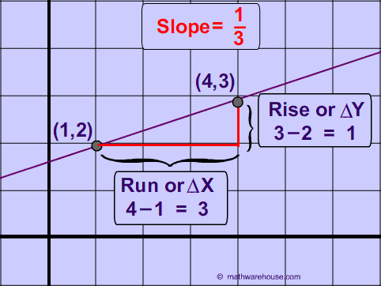
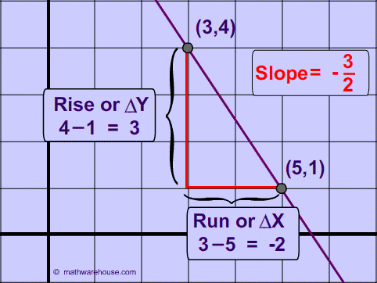
Four Types of Slope
Positive
Negative

Slide 5
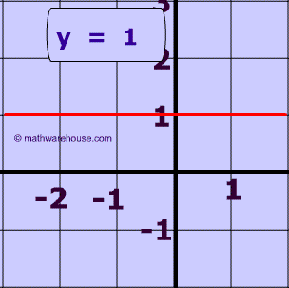
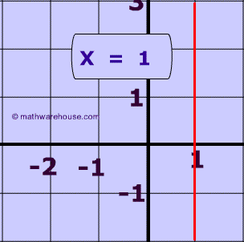
Four Types of Slope
Zero
Undefined

Slide 6
X- intercept: where the line crosses the x-axis
Y-intercept: where the line crosses the y-axis; represented by b
To solve for x, set y equal to zero
Likewise, to solve for y, set x equal to zero
3x – y – 2 = 0 3x – (0) – 2 = 0 3x – 2 = 0 3x = 2 x = 2/3
3(0) – y – 2 = 0 -y – 2 = 0 -y = 2 y = -2
X-intercept at (2/3, 0) and y-intercept at (0,-2)

Slide 7
Linear Functions
F(x) = mx + b, where m and b are real numbers
Zeros of the function f : values of x for which f(x)= 0
Constant function : m = 0, and f(x) = b
F(x) = 5x + 4 5x + 4 = 0 5x = -4 x = -4/5 (-4/5,0)
F(x) = 5(0) + 4 f(x) = 4 (0,4)
F(X) = -2 b = -2

Slide 8
Slope Intercept Form
Write an equation if the slope is -3/4 and the y-intercept is 7
Y = mx + b y = -3/4x + 7
A slope of -6 passes through the point (1,-3)
Y= mx + b -3 = -6(1) + b -3 = -6 + b 3 = b y = -6x + 3
Find the equation using point slope form
Y – (-3) = -6 (x – 1) y + 3 = -6x + 6 y = -6x + 3

Slide 9
Review Questions
Name the four types of slopes.
State the different forms of linear equations.
Write 5y - 3x + 2 = 0 in slope-intercept form
Find the zeros of 4y + 2x – 1 = 0
Find the slope of the points (3,8) and (7, -2)
Find the equation of a line with the slope of 5 and passes through the point (2,2)

