Slide 1
Graphing Linear Inequalities
Created by Tyanna Casiano and Cody Kwasniewski

Slide 2
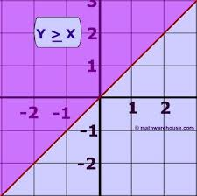
What is a linear inequality?
A linear inequality is not a function.
It is a relation whose boundary is a straight line.
On the left is an image of a very simple inequality; y≥x. The line crosses through (0,0) and the line is a straight line.

Slide 3
Lets look at the graph of y≥x
The graph of y≥x separates the coordinate plane into two regions, which is called half planes.
The line is also known as the boundary of each region. It separates each region.
This is a solid line, which is because of the ≥ or < symbol. If it was just a > or < symbol, a dashed line would be used.

Slide 4
One more thing about this graph!
In the picture you can see that
one half of the graph is shaded,
that is due to testing a point.
How do you know which side to shade?
Take a point, (0,2) for example. Test it in the equation y≥x which when done is 2≥0.
Because the statement is true, you would shade on that side of the line. If it were false, you would shade the opposite side of the line.

Slide 5
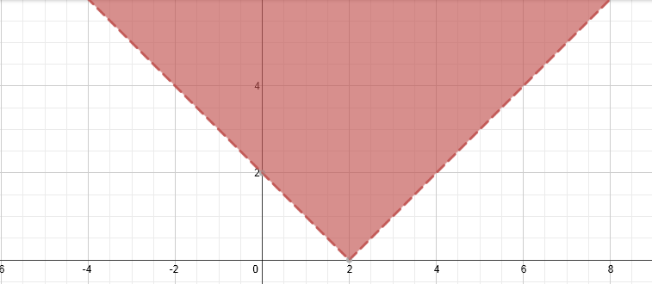
More Graphing!
Graph the equation y>|x-2|
The absolute value should be split in half when graphed and the lines should be dotted because of the > in the equation.
Test the point (0,0) to see if it works.
Since 0>2 is false, shade inside the V looking graph. (inside the dotted lines)

Slide 6
Try for yourself
y > 3x + 2
y < |x+3|
y + 1 > -5x -3
y – 2x + 1 ≤ 4

Slide 7
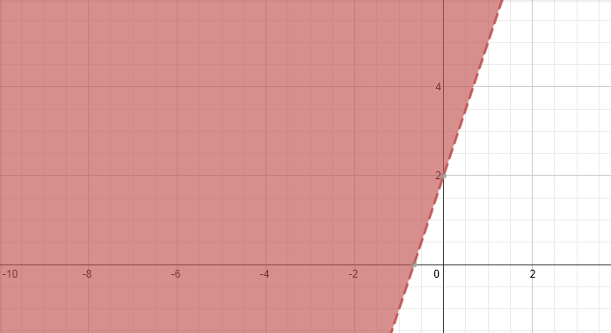
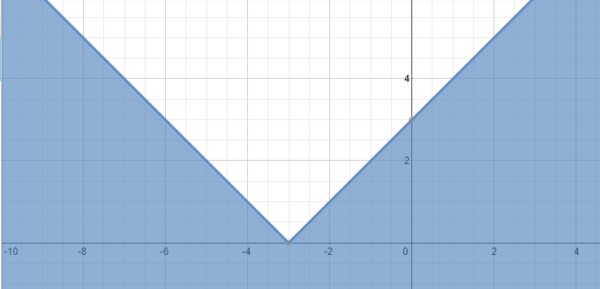
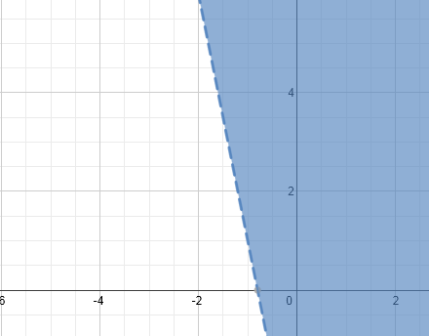
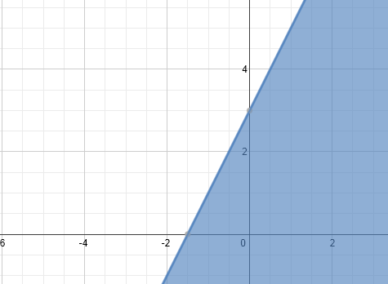
Answers
y > 3x + 2
2. y ≤ |x+3|
3. y + 1 > -5x -3 also as y>-5x-4
4. y – 2x + 1 ≤ 4 also as y≤2x+3

Slide 8
Don’t forget to ask questions!
A few that we had when we learned this section was….
“How do you know what to shade?”
Always plug in a point. If it doesn’t work and balance out, shade the other side of the line that the point wasn’t in!
“Is it a dotted line or solid line?”
These mean equal to or greater, which is a solid line: ≤ ≥
These mean less than, which is a dotted line: < >
“What if the equation isn’t simple and has y mixed in with other numbers?”
Balance it out and solve it first before you graph!

Slide 9
If you still have any questions, Mrs. Healey is always available.
Thank you!

